Slide 1
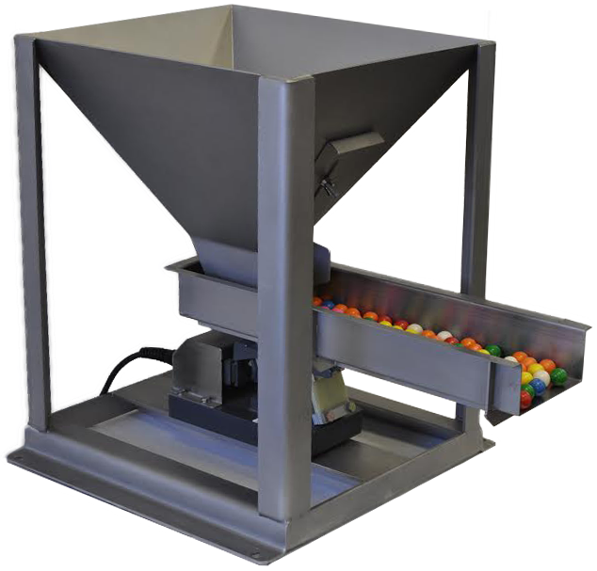
Team 1 Group Project
The Resource Hopper

Slide 2
Team Members
Joseph Couture | Nishitha B S
Ramya Bhat | Xiaoqing Ding
Aniket (AJ) Shah | Alvin Brewster

Slide 3
Project Objectives
Purpose | The Resource Hopper is a way for Project Managers/Product Owners to assemble a team of resources that are best suited for the project and identify those that are available within the project’s timetable.
Scope | The Resource Hopper is a database of project related talent that tracks potential team members based on their skill set and availability. Project Managers/Product Owners can query the database using a web page to help identify talent available for their upcoming project.

Slide 4
Roles
Team Lead: Joseph | Developer: AJ
Developer: Xiaoqing | Usability: Ramya
Developer: Nishitha | Test Expert: Alvin

Slide 5
Policy
Each iteration will run for two weeks.
Open Slack workspace throughout the iteration for people to “drop by” with questions.
Sunday night meetings on Zoom - alternate between “stand up” and “sprint retrospective/kickoff.”
All team members can submit stories to Icebox and anytime. Moved into iteration every-other Sunday.
Team members will be graded individually.

Slide 6
September 30 2019 Update
Personas Createated:
Resource
Recruiter
Project Manager
See https://drive.google.com/open?id=1LSz3gMmlu8K2gKlQ_ZtPop6ZhFialor3 for details
Nine stories added to ‘Icebox’ in PT (https://www.pivotaltracker.com/n/projects/2397216)

Slide 7
October 22 2019 Update
Configuration Item List created and uploaded to repository
Git Repo created
Entity Relationship Diagram created and uploaded to repository
Estimation record delayed to allow stories to be refined

Slide 8
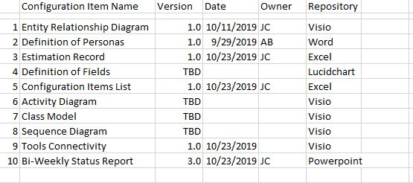
Configuration Items List
All items located in https://drive.google.com/drive/u/1/folders/1VcCcoFBlF4p89VUwmD8-pqoBmiae1q8I

Slide 9
November 4 2019 Update
Use Cases
Component Interaction Diagram
State Transition Diagram
All Configuration Items now located in
https://drive.google.com/drive/u/1/folders/10chCy9ZBz1sW4VXrgCLC6mcwV_XPnGzm

Slide 10
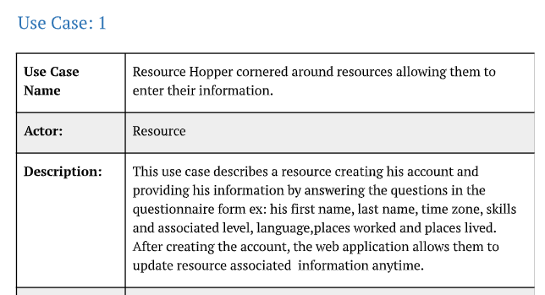
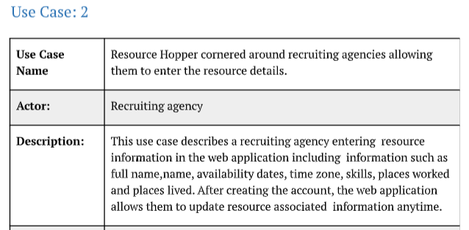
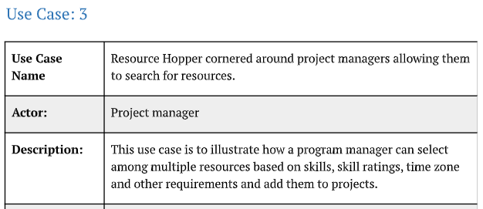
Use Cases
See CI folder for more detail
https://drive.google.com/drive/u/1/folders/10chCy9ZBz1sW4VXrgCLC6mcwV_XPnGzm

Slide 11
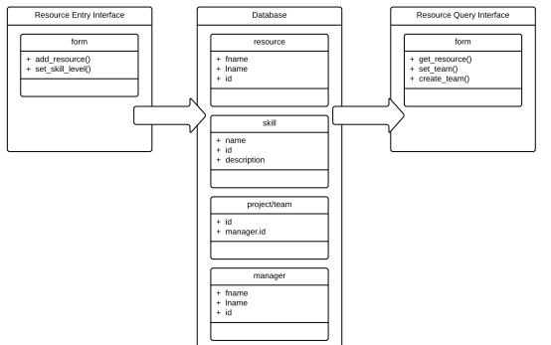
Component Interaction Diagram

Slide 12
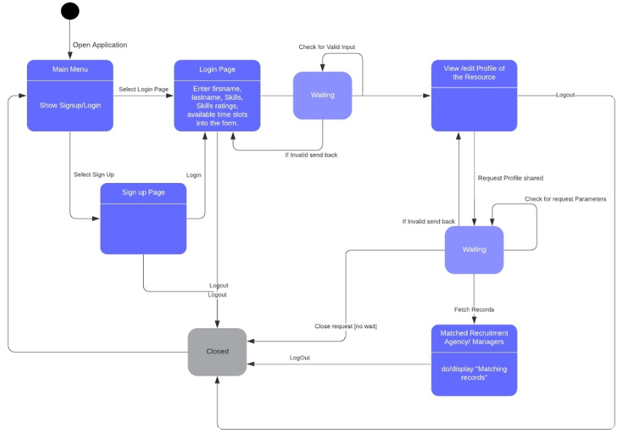
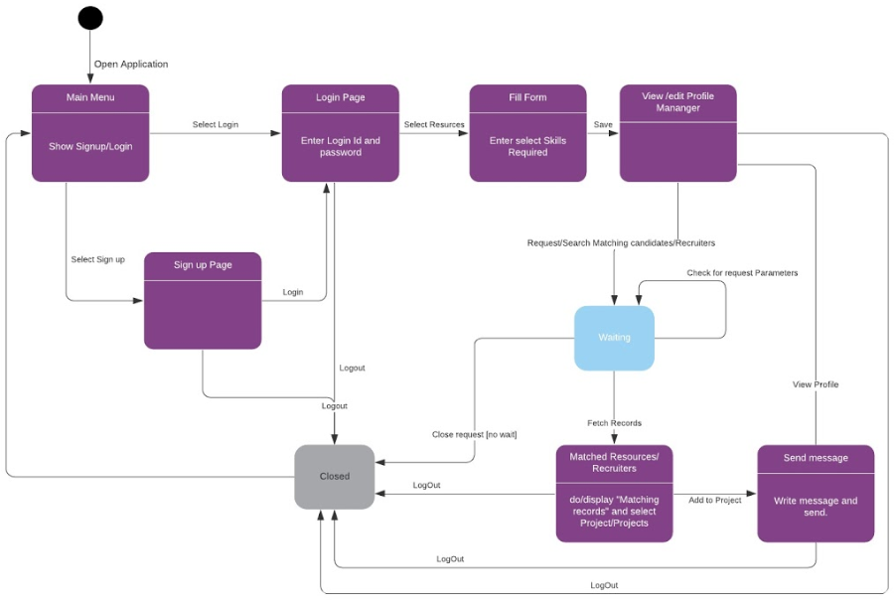
State Transition Diagrams

Slide 13
November 19 2019 Update
Wireframes
Code
All Configuration Items located in
https://drive.google.com/drive/u/1/folders/10chCy9ZBz1sW4VXrgCLC6mcwV_XPnGzm

Slide 14
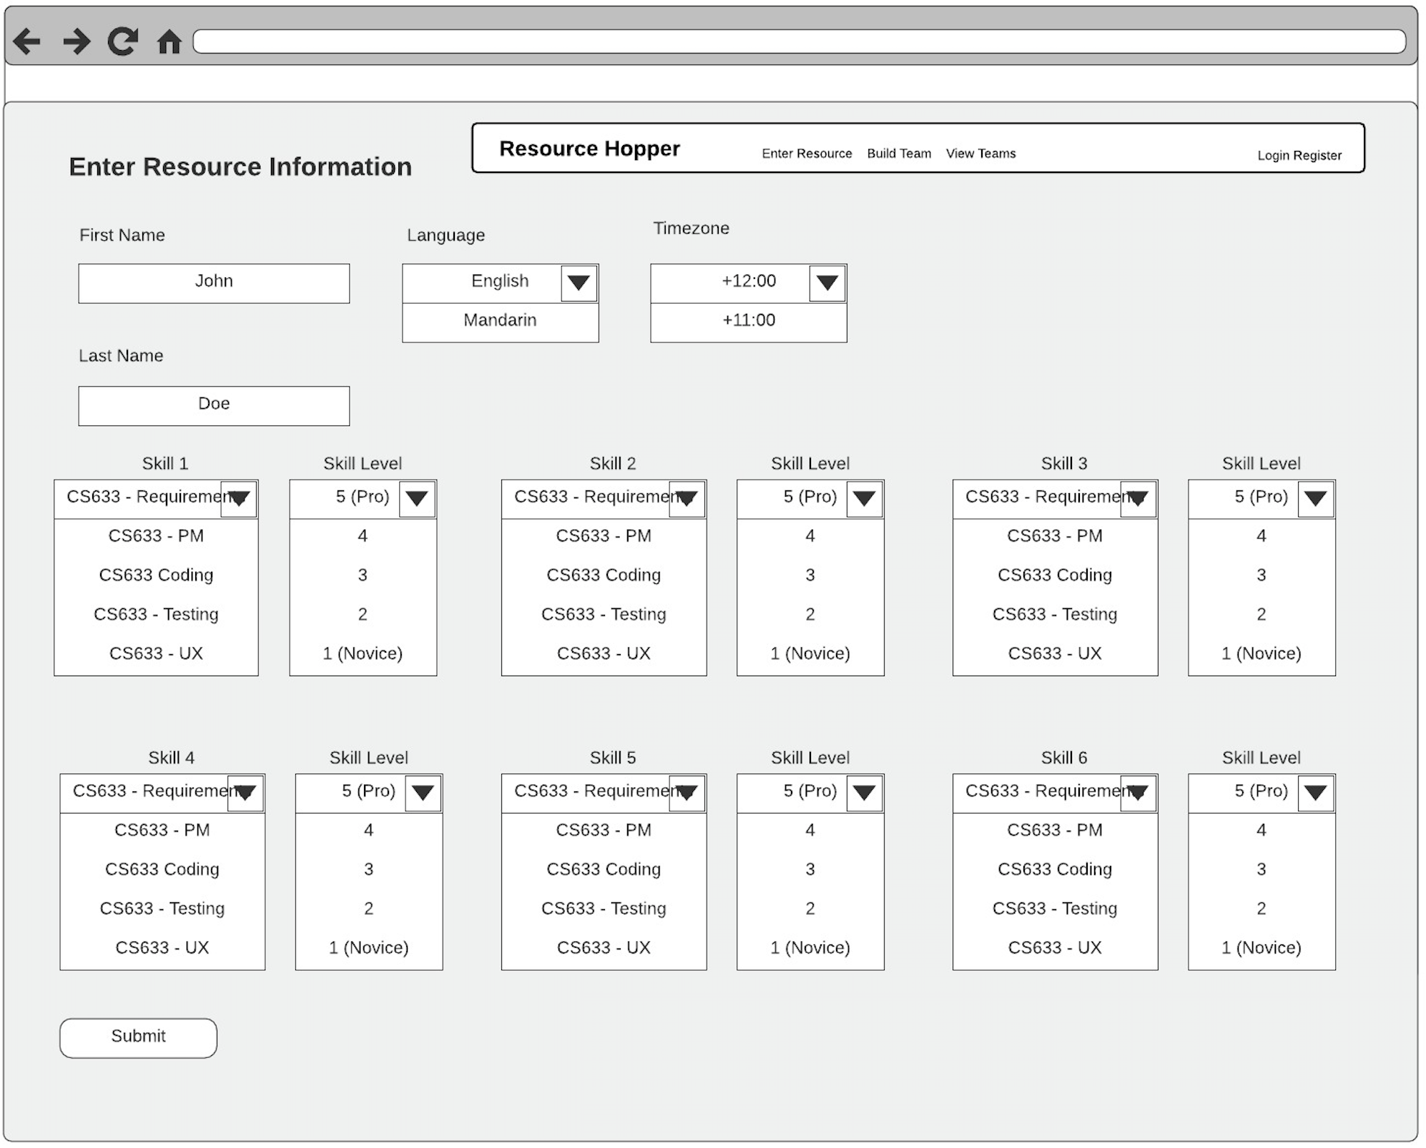
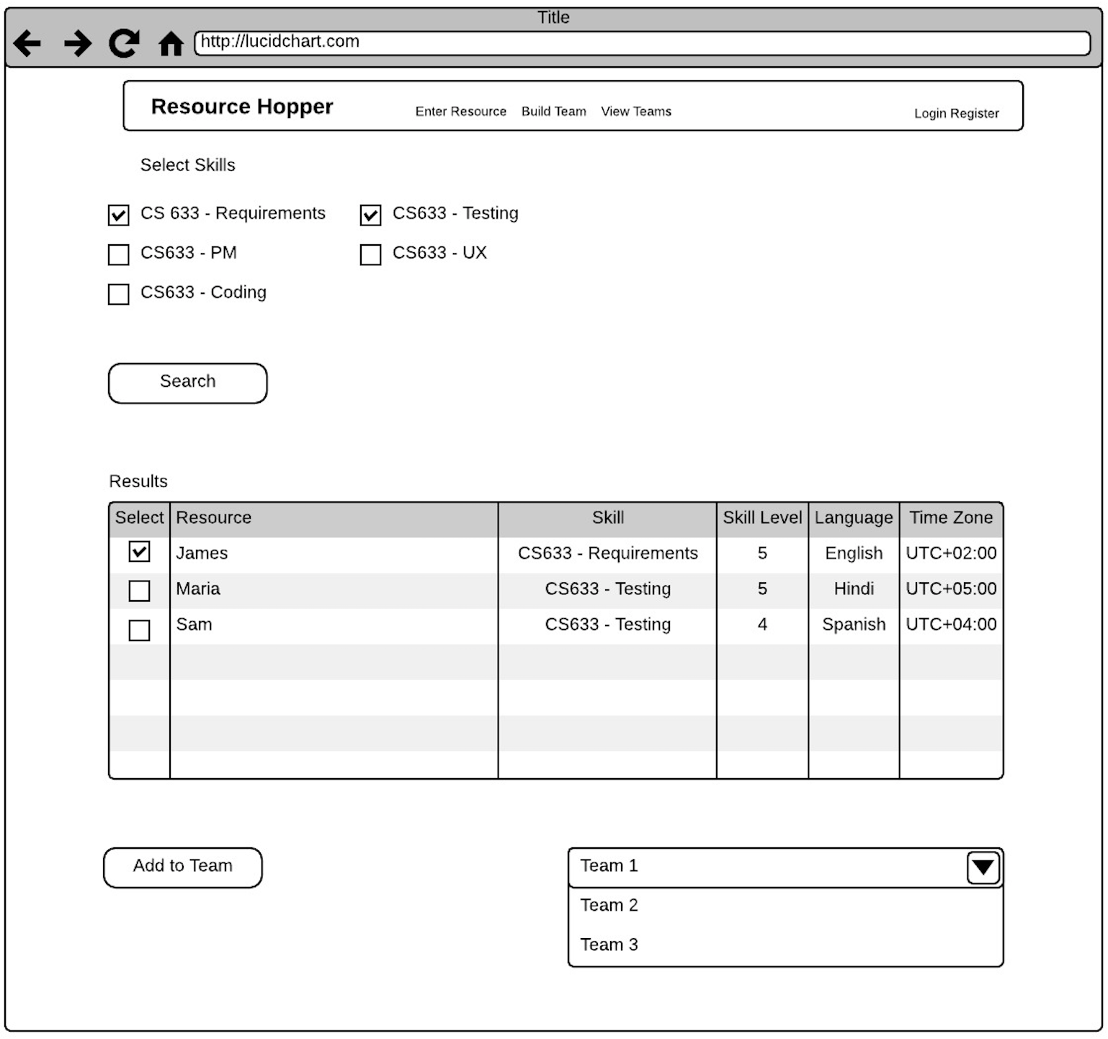
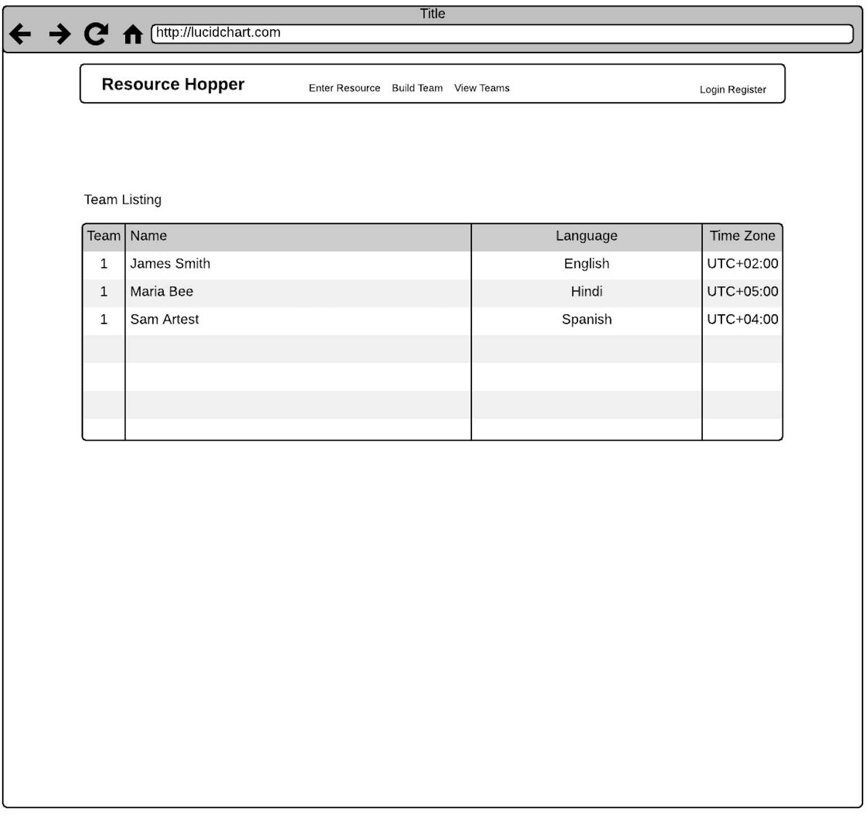
Wireframes

Slide 15
Code
Code in Progress can be viewed at: https://drive.google.com/open?id=1jAjOFXR1B5a8o782hANO3yh352Z2Is8a

